Slide 1

BRIGHT KUMEDZRO - 20764771
SECOND SEMESTER, 2023
PROJECTXCEL
A PROJECT MANAGEMENT APP
COMPUTER SCIENCE DEPARTMENT,KNUST
MINI PROJECT BY
SUPERVISOR
DR. ASAMOAH DOMINIC

Slide 2
PROJECTXCEL
COMPUTER SCIENCE DEPARTMENT,KNUST
A PROJECT MANAGEMENT APP
TABLE OF CONTENTS
INTRODUCTION/PROBLEM MOTIVATION
PROBLEM STATEMENT
AIM OF PROJECT
MODEL/ ANALYSIS
CHALLENGES/RESULTS
CONCLUSION

Slide 3
PROJECTXCEL
COMPUTER SCIENCE DEPARTMENT,KNUST
A PROJECT MANAGEMENT APP
INTRODUCTION/PROBLEM MOTIVATION
The proposed project addresses a critical need within the Computer Science Department to establish an efficient and structured system for managing student project works.
The existing manual approach to overseeing projects lacks the required level of organization, preventing effective project tracking, encouraging originality, and providing resources for project enhancement.
To bridge these gaps, the project aims to develop a comprehensive web application that revolutionizes project management and elevates student engagement within the department.

Slide 4
PROJECTXCEL
COMPUTER SCIENCE DEPARTMENT,KNUST
A PROJECT MANAGEMENT APP
PROBLEM STATEMENT
The Computer Science Department recognizes the need for an effective project management solution.
This project aims to develop a comprehensive web app to address these challenges, providing tracking, prevention, and resources. The app offers an organized platform for student projects, bridging gaps in oversight, preventing duplication, and fostering continuous improvement.

Slide 5

PROJECTXCEL
COMPUTER SCIENCE DEPARTMENT,KNUST
A PROJECT MANAGEMENT APP
AIM OF PROJECT
A PROJECT MANAGEMENT APP
This project aims to promote innovation and originality amongst our students
This will be achieved through:
Efficient Project Tracking
Project Duplication Check
Provision of resourrces/suggestions for improving existing projects
A user friendly interface for project submission and accessment

Slide 6
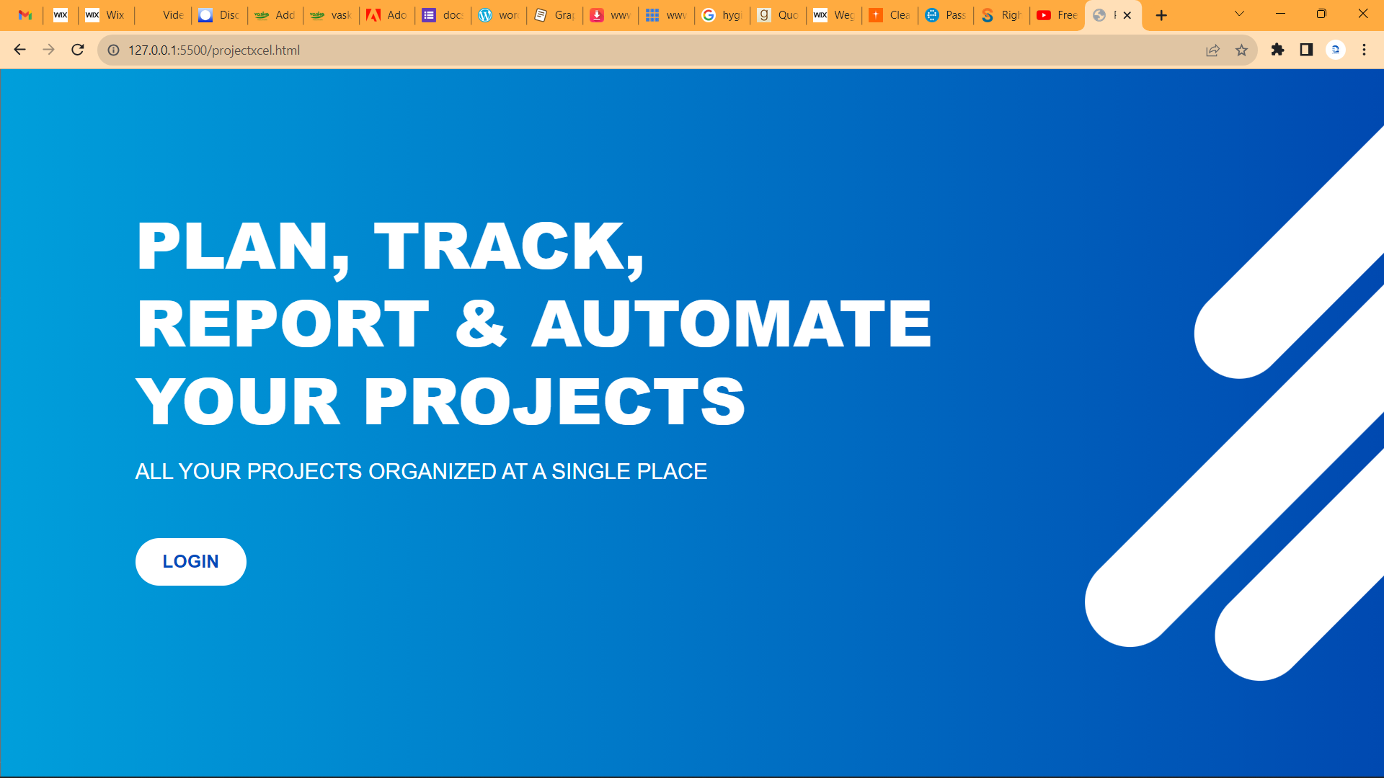
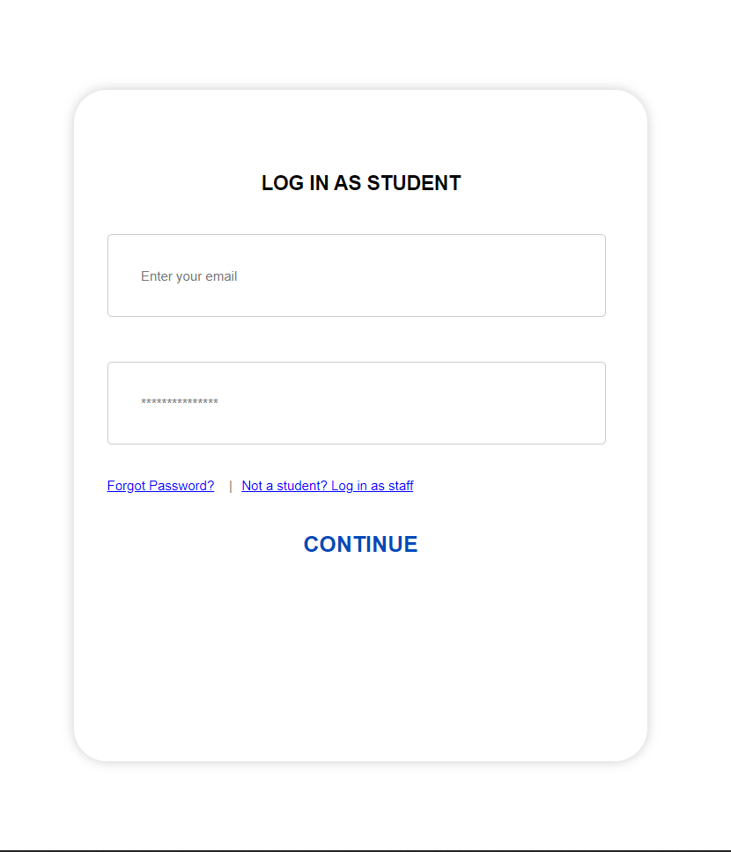
PROJECTXCEL
COMPUTER SCIENCE DEPARTMENT,KNUST
A PROJECT MANAGEMENT APP
MODEL/ANALYSIS
A PROJECT MANAGEMENT APP
This sectionpresents the wireframes and mockups of the user interface designs for the web application. The visual representations illustrate the layout, navigation, and interaction flow of key pages, ensuring a user-centered design approach.
THE LANDING PAGE
THE LOGIN PAGE

Slide 7
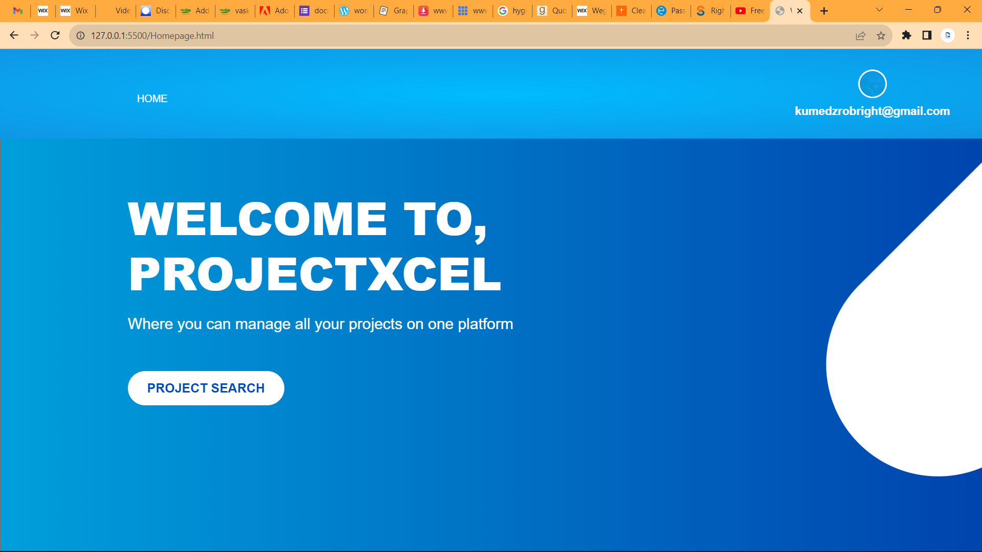
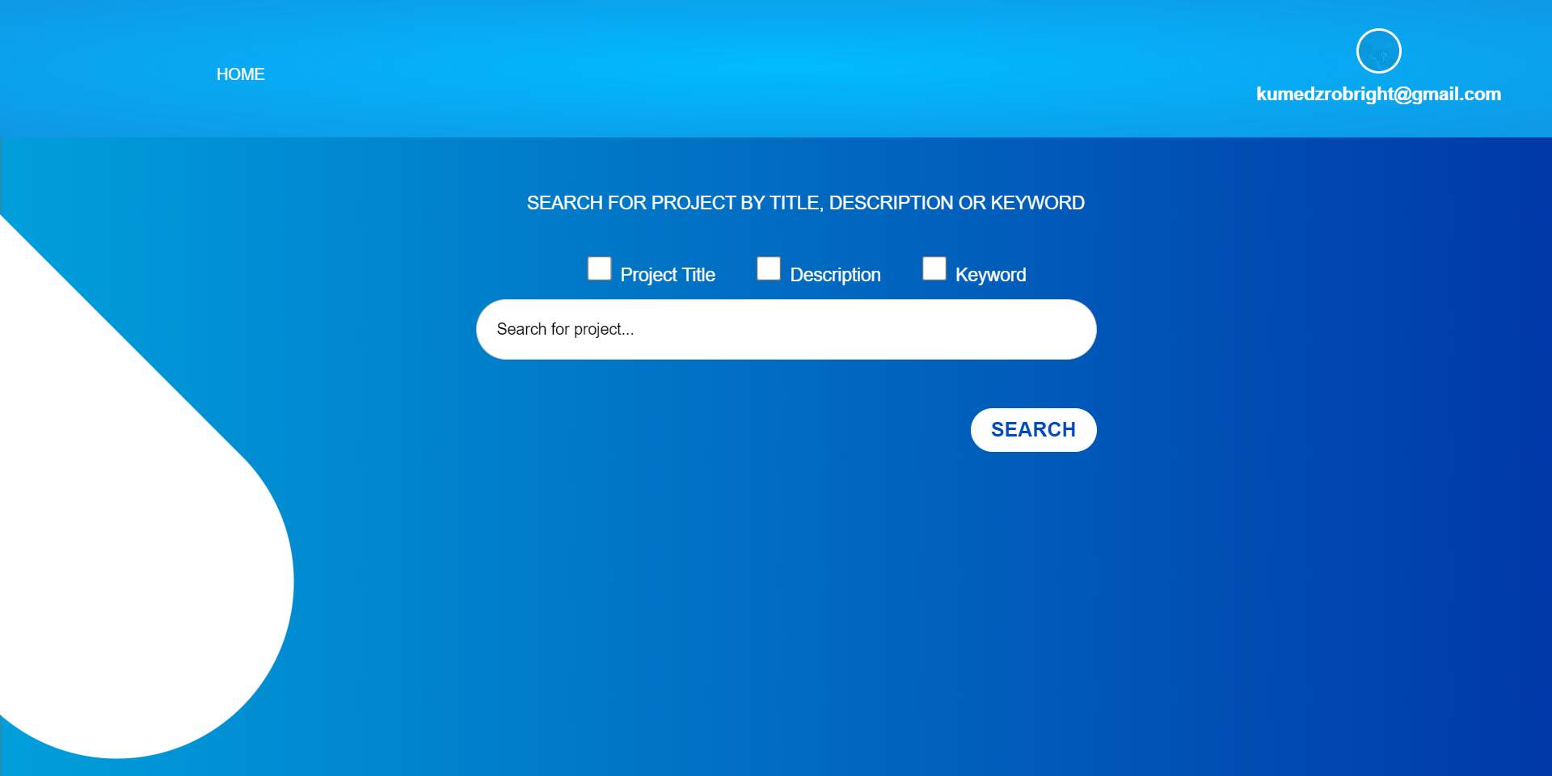
PROJECTXCEL
COMPUTER SCIENCE DEPARTMENT,KNUST
A PROJECT MANAGEMENT APP
MODEL/ANALYSIS CON’T
A PROJECT MANAGEMENT APP
THE HOMEPAGE
After the user logs in, his/her details are
recorded and the username displayed at
the profile section
THE SEARCH PAGE
The user moves on to search for a project

Slide 8
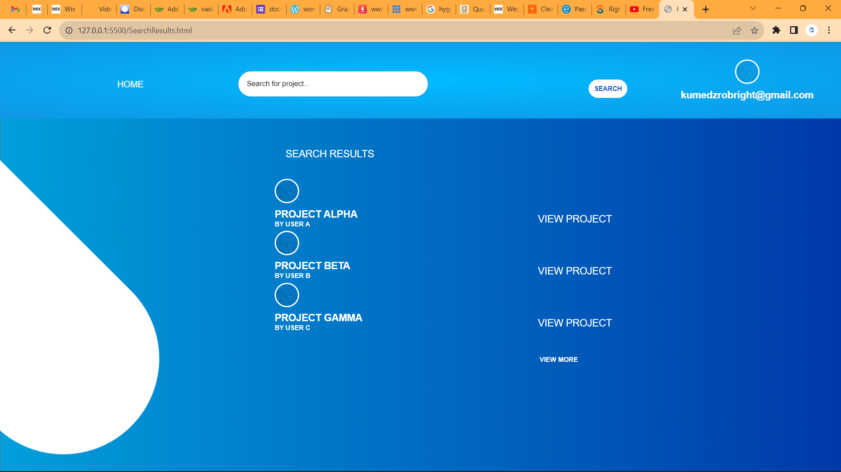
PROJECTXCEL
COMPUTER SCIENCE DEPARTMENT,KNUST
A PROJECT MANAGEMENT APP
MODEL/ANALYSIS CON’T
A PROJECT MANAGEMENT APP
THE SEARCH RESULTS PAGE
Results from searches are displayed from
which the user can select a project

Slide 9

PROJECTXCEL
COMPUTER SCIENCE DEPARTMENT,KNUST
A PROJECT MANAGEMENT APP
CHALLENGES/RESULTS
A PROJECT MANAGEMENT APP
Some challenges encountered during ProjectXcel’s development include constraints in resource availability(student information and projects availability) and time limitations for comprehensive development, testing and potential variations in user preferences. Addressing these limitations and refining the system's functionality would require continuous efforts and a proactive approach to user feedback.
The user-friendly interface and the availability of resources for project improvement contribute to a positive user experience. Rigorous testing and adherence to security measures ensure the reliability, performance, and confidentiality of student project information. The successful deployment of the web application within the department's infrastructure, coupled with ongoing support and maintenance, will solidify its role as a sustainable solution.

Slide 10

PROJECTXCEL
COMPUTER SCIENCE DEPARTMENT,KNUST
A PROJECT MANAGEMENT APP
CONCLUSION
The realization of the proposed web application marks a significant step toward enhancing project management practices within the Computer Science Department. By addressing the identified need for efficient project oversight and duplication prevention, the web application will serve as a valuable tool for both students and staff. The implementation of the duplication check mechanism will ensure the authenticity and diversity of project ideas, promoting a culture of innovation and originality.

Slide 11
PROJECTXCEL
COMPUTER SCIENCE DEPARTMENT,KNUST
A PROJECT MANAGEMENT APP
END OF PRESENTATION
THANK YOU

